Slide 1
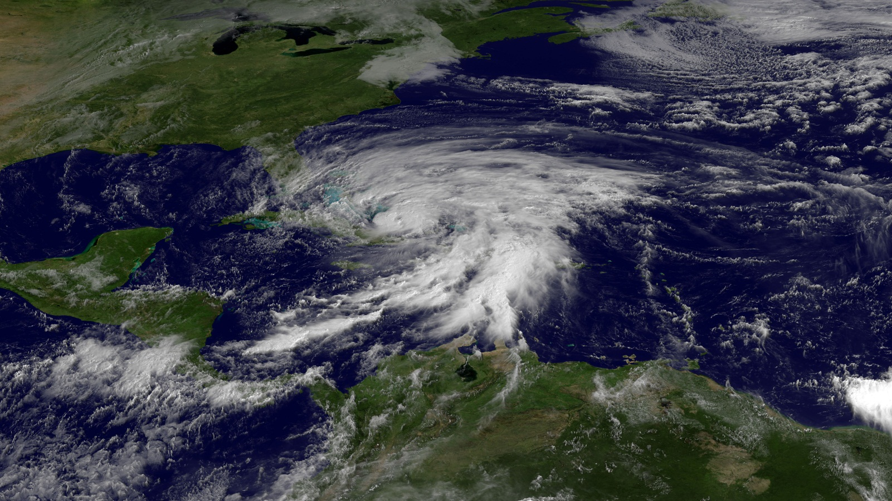
67th Interdepartmental Hurricane Conference
Tropical Cyclone Research Forum
Hurricane Sandy
Tropical Cyclone Research: Our Vision for the Future
March 5 – 7, 2013
Notes:
Leave this slide on the screen as the FC walks to podium

Slide 2
Forum Opening
Mr. Samuel P. Williamson
Federal Coordinator for Meteorology
67th Interdepartmental Hurricane Conference
Tropical Cyclone Research Forum
Tropical Cyclone Research: Our Vision for the Future
The Office of the Federal Coordinator for
Meteorological Services and Supporting Research
Notes:
Good morning! To those in attendance and to those who are participating via the Internet, I want to say thank you for being a part of this first-time experience for us.
As you can see from our theme, our focus during the next 3 days will be on tropical cyclone research--where we stand, what new capabilities are on the horizon, and how we need to proceed in the future as interagency partners.
We are excited and a little anxious about this year’s forum. Because of travel restrictions and other budgetary considerations, we will have approximately 150 “virtual” attendees, participating via the Internet, including international participation from the United Kingdom and Canada—attendees who would otherwise be unable to participate in this important forum.
Next, I want to gratefully acknowledge the sponsors of this year’s forum—NOAA, NSF, and the Office of Naval Research. Without their support, this effort would not have been possible.
Finally, before I introduce our first speaker, Dr. Louis Uccellini, I want to remind you that this is a first-time experience for us, and there are going to growing pains, particularly when transitioning from in-person presentations to “virtual” presentations. And I thank you in advance for your patience as we work together to make this event as successful as possible.

Slide 3
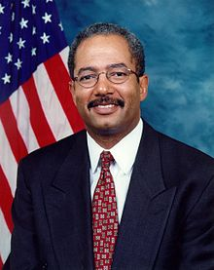
Keynote Address
Representative Chaka Fattah
U. S. House of Representatives Appropriations Committee
Subcommittee on Commerce, Justice, Science, and
related agencies (CJS)
67th IHC/Tropical Cyclone Research Forum
Notes:
We are extremely pleased and honored to have Congressman Fattah with us this morning.
Congressman Fattah is a senior member of the House Appropriations Committee and the ranking member of the Subcommittee on Commerce, Justice, Science and related agencies.
He is a strong supporter of NOAA and the National Weather Service, most recently defending the importance of keeping weather satellite systems upgrades in support of the National Weather Service and its mission of saving lives and property firmly on track, during Congressional deliberations on the 2013 Disaster Relief Appropriations Act.
-Congressman Fattah is Chairman of the Congressional Urban Caucus, a bipartisan group of 57 Members of Congress representing America's metropolitan centers. He leads the Fattah Neuroscience Initiative (FNI), an innovative, non-incremental policy initiative designed to make major progress in understanding the human brain by intensifying, in a collaborative fashion, federal research efforts across brain disease, disorder, injury, cognition and development, and his legislative victories include
the American Opportunity Tax Credit Act, a $14 billion program to provide a $2,500 tax credit for tuition and other expenses for college students or their parents, has assisted 12.5 million students in meeting their college expenses plus the Congressman secured $3.2 billion for the Energy Efficiency and Conservation Block Grants Program that will assist over 1,041 local communities in the development of programs to implement various energy efficiency and conservation projects.
-Please join me in welcoming Congressman Chaka Fattah

Slide 4
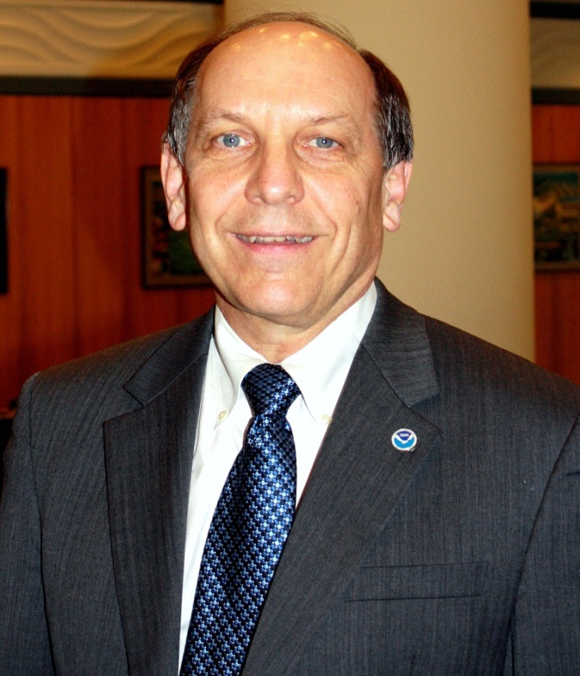
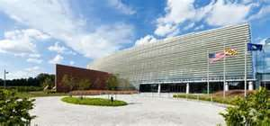
Welcoming Remarks
Dr. Louis W. Uccellini
NOAA Assistant Administrator for Weather Services
Director, National Weather Service
67th IHC/Tropical Cyclone Research Forum
Notes:
-On February 10th, Louis Uccellini became the NOAA assistant administrator for weather services and the 16th director of NOAA’s National Weather Service.
-In his previous job, he led the National Weather Service’s National Centers for Environmental Prediction (NCEP), which this past October, moved into this beautiful, new, state-of-the-art facility.
-At NCEP, in addition to shepherding his organization into this wonderful facility, he was responsible for directing the planning, science and technology, and operational responsibilities related to NCEP’s Central Operations and Environmental Modeling, as well as seven other national centers, including the National Hurricane Center.
-And thanks to Dr. Uccellini, we have this beautiful location to conduct this important forum.
-Ladies and Gentlemen, please give a warm welcome to the mayor of the NOAA Center for Weather and Climate Prediction—Dr. Louis Uccellini.

Slide 5
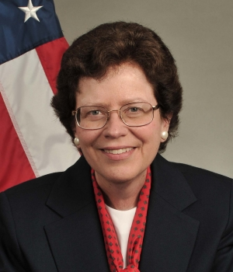
Invited Comments
Dr. Rebecca M. Blank
Acting Secretary of Commerce
Deputy Secretary of Commerce
67th IHC/Tropical Cyclone Research Forum
Notes:
Dr. Blank is a key member of President Obama’s economic team working to implement the administration’s top economic priorities to increase economic growth and accelerate job creation.
She leads the Department’s efforts to strengthen U.S. competitiveness, helping make American businesses more innovative and successful at home and more competitive abroad, and to create good-paying jobs.
In her role as Deputy Secretary, Dr. Blank also functions as Commerce’s chief operating officer, overseeing issues of management, policy and strategic planning for the department’s 12 bureaus.
Prior to arriving at Commerce, Dr. Blank was the Robert S. Kerr Senior Fellow at the Brookings Institution and dean of the Gerald R. Ford School of Public Policy at the University of Michigan (UM), where she implemented a major expansion of its faculty and programs. She also served as co-director of UM’s National Poverty Center.
We are deeply honored that Dr. Blank is with us today. Please join me in giving her a warm welcome.
Dr. Blank

Slide 6
Setting the Stage
Mr. Samuel P. Williamson
Federal Coordinator for Meteorology
67th IHC/Tropical Cyclone Research Forum
Tropical Cyclone Research: Our Vision for the Future
Notes:
6
- This year marks the 67th edition of this extremely successful interagency conference. As I mentioned earlier, we’ve had to take a different approach this year to keep this important interagency effort moving forward, and I greatly appreciate your participation in making this a very productive and informative three days.
- At last year’s conference, we recognized the important role that partnerships and alliances play in our ability to provide improved tropical cyclone forecast and warning services to our Nation.
As part of this year’s program, senior leaders will provide their invaluable perspectives on addressing critical challenges in these areas.
- This year’s agenda also reflects your inputs to include emphasis on storm surge as well as a special 2-part panel session on Thursday morning to address effective communications and social science issues and efforts.
- In the next few slides, as part of my introductory comments, I will provide a brief reminder of why we’re here, review the conference objectives, and highlight some of the agenda items for the remainder of the week.

Slide 7
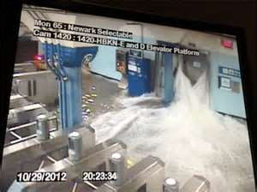
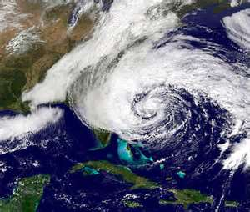
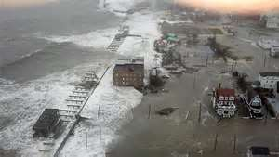
Reminder of Why Are We Here
Hurricane Sandy is just the most recent example of the need to work together to provide improved services to help prevent injuries and the loss of life.
We must build upon the synergy and collaboration we’ve achieved in the tropical cyclone community over the last 5 years to reassess the gaps in our capabilities and adjust our priorities, as necessary, moving forward to:
Ensure we get the “biggest bang for the buck” in a tough budgetary climate
Ultimately, minimize the Nation’s vulnerability to nature’s most destructive forces
Notes:
7

Slide 8
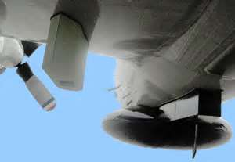
Forum Objectives
Assess the progress in addressing the operational priorities of the operational centers (NHC, CPHC, and JTWC) and adjust future research priorities as needed
Review ongoing numerical modeling initiatives within NOAA, Navy, NASA, and NSF
Receive updates on Joint Hurricane Testbed projects ready for
transition from research
into operations
Explore other R&D opportunities (modeling and observational) that will promote improvements in
forecasting and understanding of TCs
and their associated effects
Investigate the application of social
science to the TC forecast and warning
notification problem

Slide 9
Forum Agenda
This Morning
The Emergency Response to Hurricane Sandy
Moderator: Bryan Norcross, TWC Hurricane Specialist
Panelists: Captain Thomas Scardino, NJ EM
Mr. Richard A. French, NY EM
10:00 AM – 12:00 PM
Senior Leader Panel:
Tropical Cyclone Research: The View from the Top
Moderator: John D. Murphy (NWS/OST)

Slide 10
Forum Agenda
This Afternoon
1:00 PM – 1:30 PM
Working Group for Tropical Cyclone Research (WG/TCR)
Comparison of the 2010 and 2012 Snapshots of TC R&D
1:30 PM – 3:00 PM
The Navy’s Model Development and Improvement Program/
Hurricane Forecast Improvement Program:
Supporting Talks

Slide 11
Forum Agenda
This Afternoon
3:30 PM – 5:00 PM
Earth System Prediction Capability/
Next-Generation Suite of Models:
Supporting Talks
5:15 PM
Poster Previews
5:30 PM – 7:00 PM
Poster Session/Ice Breaker

Slide 12
Forum Agenda
Day 2 – Wednesday, 6 March
8:05 AM – 9:35 AM
NSF Program Initiatives:
Supporting Talks
10:00 AM – 5:30 PM
The 2012 Forecast Season in Review
Joint Hurricane Testbed Project Updates, Parts 1 & 2
TC Model Development and Technology Transfer
Notes:
12

Slide 13
Forum Agenda
Day 3 – Thursday, 8 March
8:05 AM – 12:30 PM
Observations and Observing Strategies for
Tropical Cyclones and their Environment
Improvements in TC Forecast and Warning
Products and Services
12:30 PM
Forum Banquet
Presentation of the Hagemeyer Award
1:30 PM – 1:45 PM
Invited Speaker - Mr. David Jones
President & CEO, StormCenter Communications Inc.
1:45 PM – 3:15 PM
Social Science Applications to the TC Forecast
and Warning Notification Problem

Slide 14
Forum Agenda
Day 3 – Thursday, 8 March
Final Plenary Session
3:15 PM – 4:30 PM
WG/HWSOR: Action Item Review
Conference Wrap-up
Final Wrap-Up
Adjourn

Slide 15
Conference Logistics
Chair: Mr. Samuel P. Williamson
Forum Technical Director Assistant Director | Mr. Bob Dumont Ms. Erin McNamara
Forum Coordinator for Logistics | Ms. Erin McNamara
Audiovisual | Mr. Ken Barnett Mr. Tony Ramirez
Registrars | Ms. Meg Austin, UCAR Ms. Susan Baltuch,UCAR Ms. Kendra Greb,UCAR
Session Coordinators | Dr. Paul Try Col Gary Kubat Ms. Susan Callis Mr. Floyd Hauth Dr. Daniel Melendez Mr. Bob Dumont
Notes:
15

Slide 16
Special Panel
The Emergency Response to
Hurricane Sandy
Moderator: Bryan Norcross, TWC Hurricane Specialist
Panelists: Captain Thomas Scardino, Executive Officer,
Emergency Management Section,
New Jersey Homeland Security Branch
Mr. Richard A. French,
New York State
Office of Emergency Management
Notes:
-Our panel moderator—Bryan Norcross—has been a long-time supporter of this interagency forum. Brian holds a Master’s degree in Communications and Meteorology from Florida State University and Honorary Doctor of Public Service degree from Florida International University.
-Brian is currently the Hurricane Specialist at The Weather Channel. Previously, he was a meteorologist for WFOR-TV (the CBS owned-and-operated television station in Miami, Florida) and the chief hurricane analyst for CBS News in New York.
-During the 1990s, Norcross became a regular fixture on CBS's national newscasts during hurricane season.
-His most memorable weather event occurred on Sunday evening, August 23, 1992 when he realized that Hurricane Andrew was absolutely, for sure going to be the near-worst case for a large number of people in the southern half of Dade County, FL. And we all know the havoc and destruction that Hurricane Andrew left in its wake.
-Brian, thank you agreeing to moderate this important panel.

Slide 17
Senior-Leader Panel
Tropical Cyclone Research:
The View from the Top
Moderator: John D. Murphy, Director, Office of Science and Technology, NOAA/NWS
Panelists: Dr. Jack Kaye, NASA
Dr. Ronald Ferek, ONR
Dr. Frank Marks, Jr., NOAA
Dr. Alexander E. (Sandy) MacDonald, NOAA
Dr. Michael C. Morgan, NSF

Slide 18
67th Interdepartmental Hurricane Conference
Tropical Cyclone Research Forum
Hurricane Sandy
Tropical Cyclone Research: Our Vision for the Future
March 5 – 7, 2013
Notes:
Leave this slide on the screen as the FC walks to podium

Slide 19
BACK- UP SLIDES

Slide 20
Forum Agenda
Day 2 – Wednesday, 6 March
8:05 AM – 9:35 AM
NSF Program Initiatives:
Supporting Talks
10:00 AM – 5:30 PM
The 2012 Forecast Season in Review
Joint Hurricane Testbed Project Updates, Parts 1 & 2
TC Model Development and Technology Transfer
6:00 PM
Forum Banquet
Presentation of the Hagemeyer Award
Notes:
20

